Slide 1
Robotics
09
Communications
WebSocket (2)
TEKNIK
TEKNIK ELEKTRO
Zendi Iklima ST, SKom, MSc

Slide 2
Definition
A WebSocket is a standard protocol for two-way data transfer between a client and server. The WebSockets protocol does not run over HTTP, instead it is a separate implementation on top of TCP.
10.162.1.58:3000

Slide 3
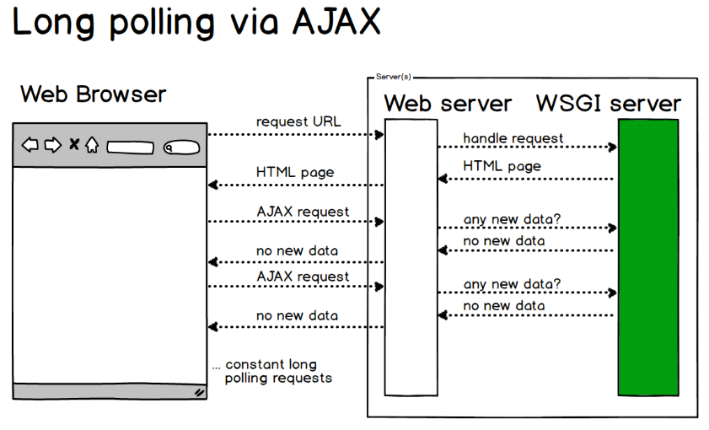
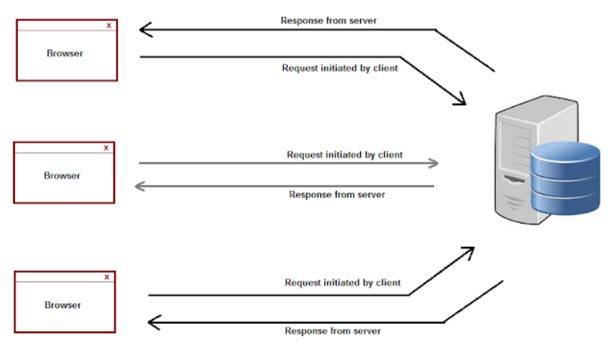
Ajax Request

Slide 4
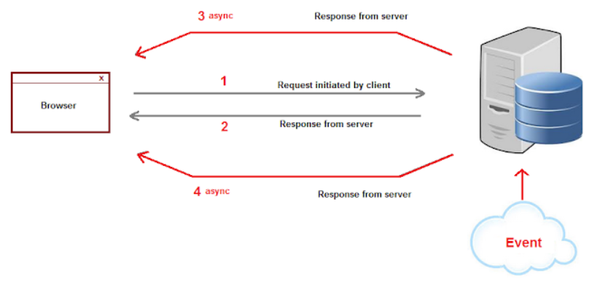
Ajax Request

Slide 5
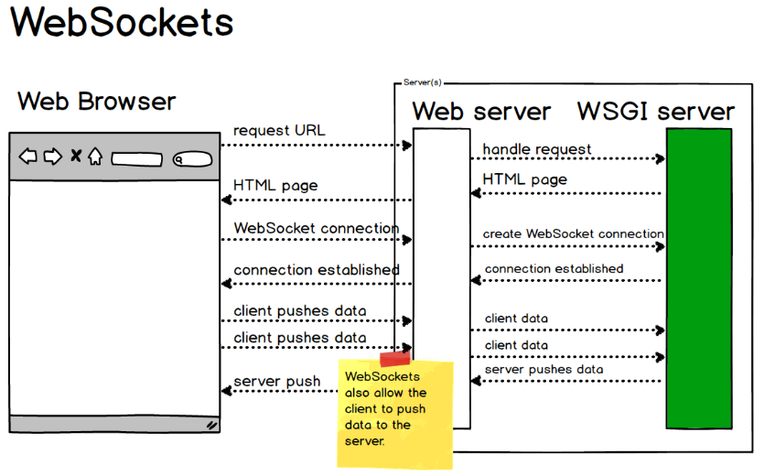
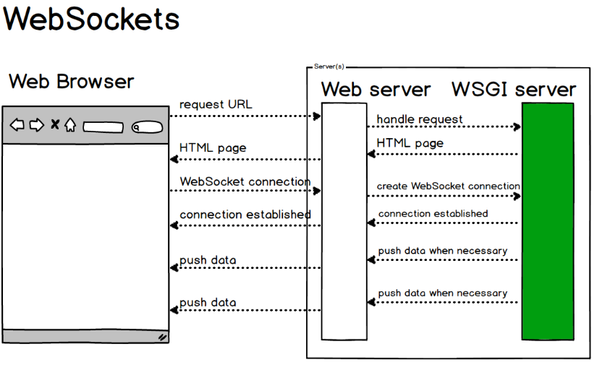
WebSockets

Slide 6
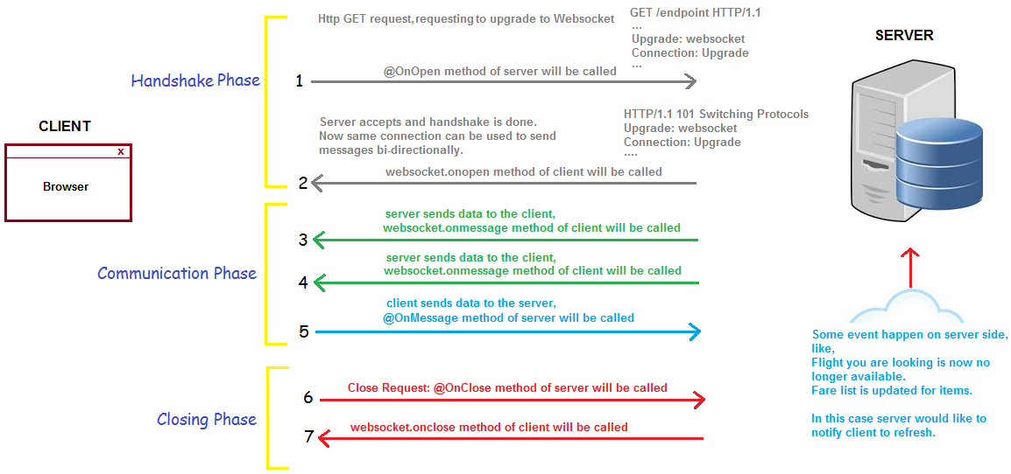
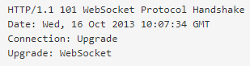
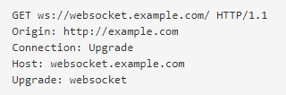
WebSocket Workflow

Slide 7
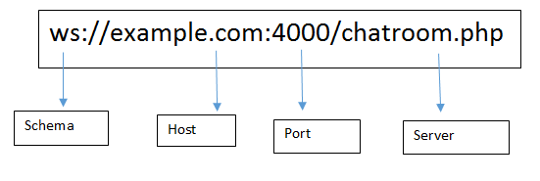
WebSocket Protocol Shema

Slide 8


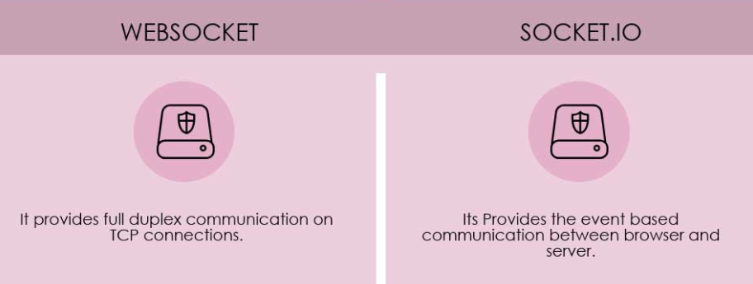
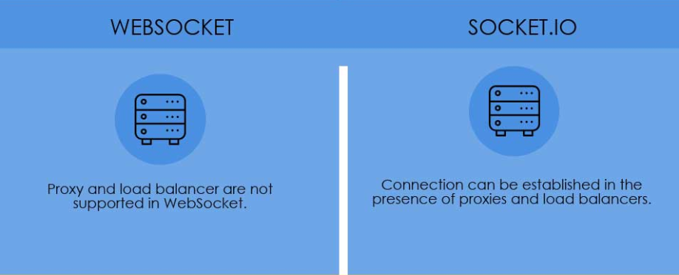
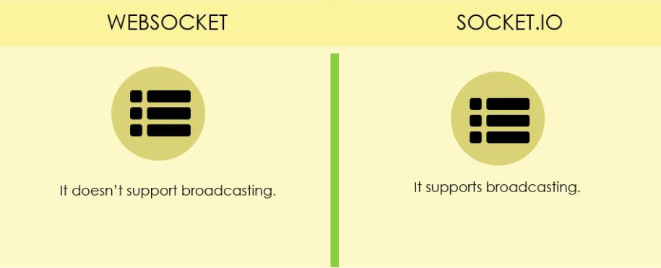
WebSocket VS Socket.io

Slide 9
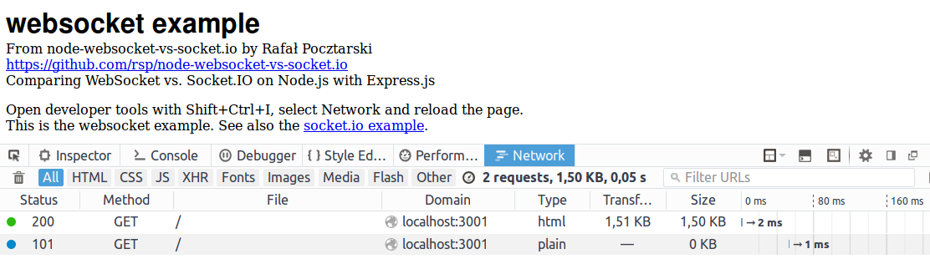
WebSocket VS Socket.io
Network traffic
WebSocket Results
2 requests, 1.50 KB, 0.05 s

Slide 10
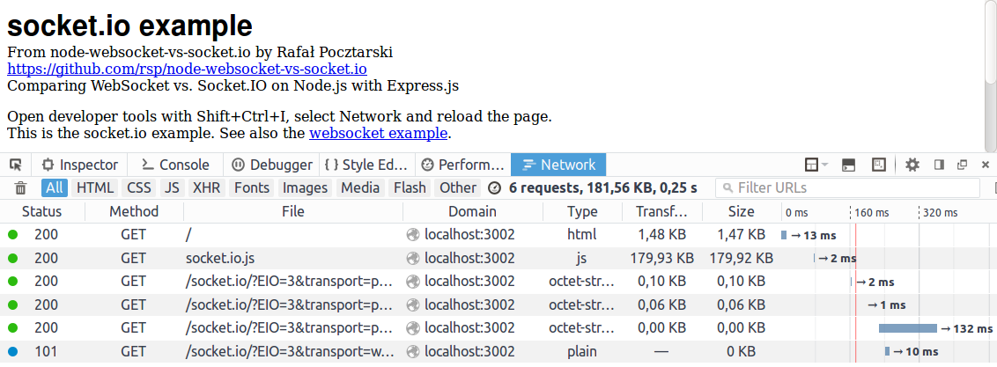
WebSocket VS Socket.io
Network traffic
Socket.IO Results
6 requests, 181.56 KB, 0.25 s

Slide 11
Our Rules
Web Socket Server
Web Socket Client
on(“connection”)
emit(“connection”)
data = ‘a client connected’
emit(“message”)
on(“message”)
on(“disconnect”)
emit(“disconnect”)
data = ‘a client disconnected’

Slide 12
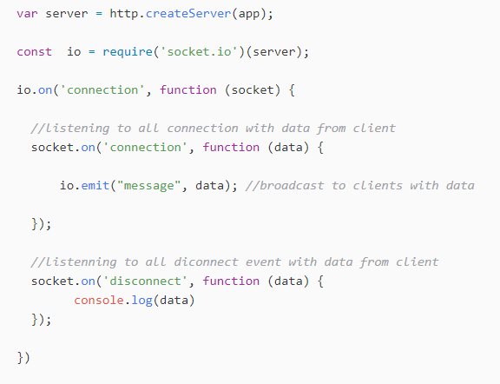
Implementation
/bin/www

Slide 13
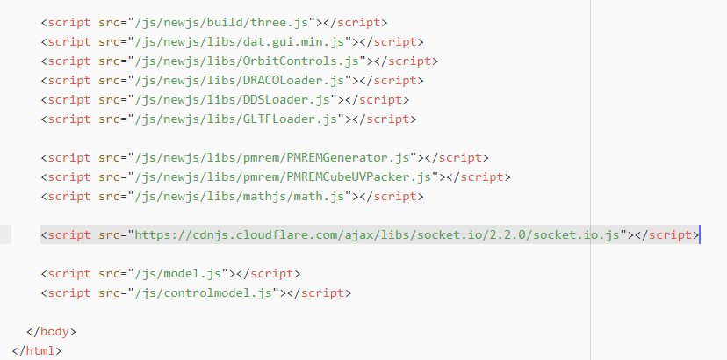
Implementation
/views/footer.ejs

Slide 14
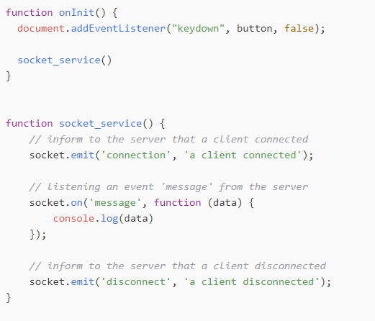
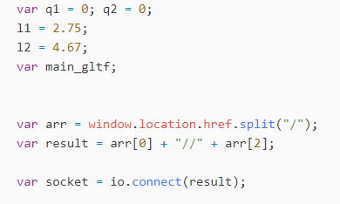
Implementation
/public/js/controlmodel.js

Slide 15
Our Rules
Web Socket Server
Web Socket Client
on(“connection”)
emit(“connection”)
emit(“message”)
on(“message”)
on(“update_pos”)
emit(“update_pos”)
FK data
emit(“update_pos”)
on(“update_pos”)
on(“disconnect”)
emit(“disconnect”)

Slide 16
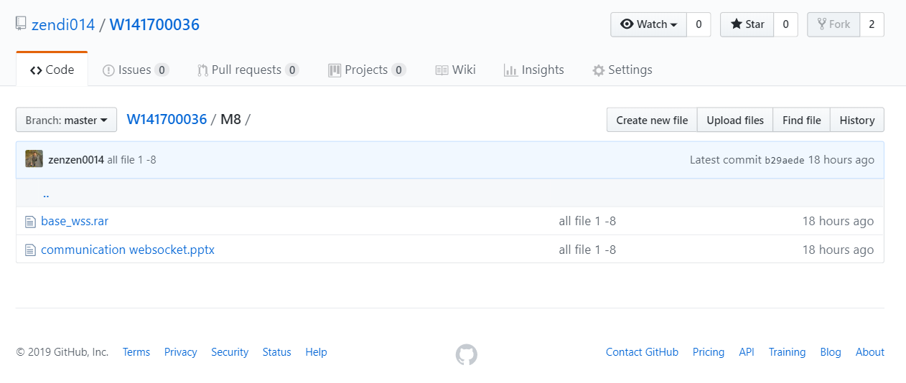
Implementation

Slide 17
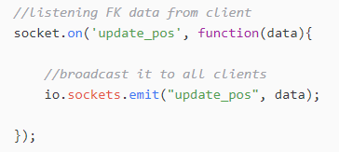
Implementation
/app.js

Slide 18
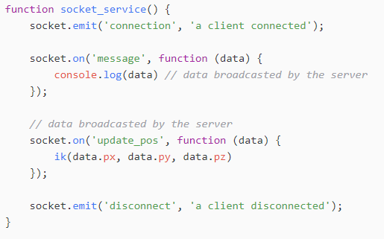
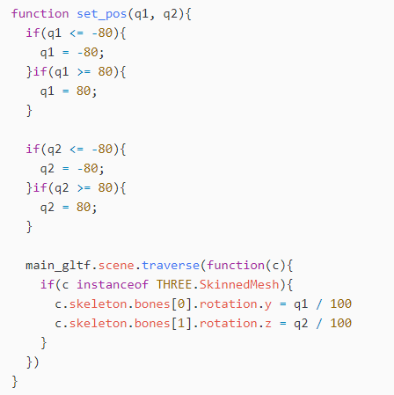
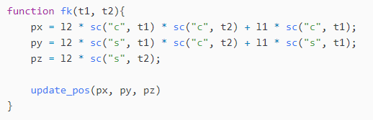
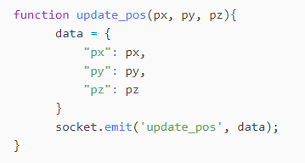
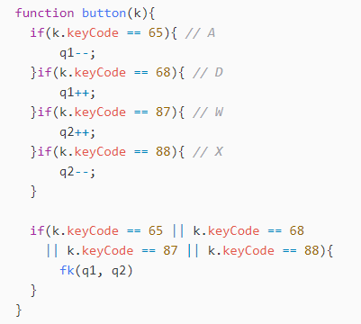
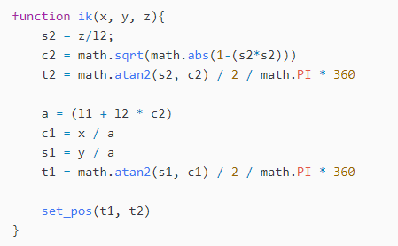
Implementation
/public/js/controlmodel.js

Slide 19
Our Rules
Web Socket Server
Web Socket Client
on(“connection”)
emit(“connection”)
emit(“message”)
on(“message”)
on(“update_pos”)
emit(“update_pos”)
FK data
emit(“update_pos”)
on(“update_pos”)
on(“disconnect”)
emit(“disconnect”)

Slide 20
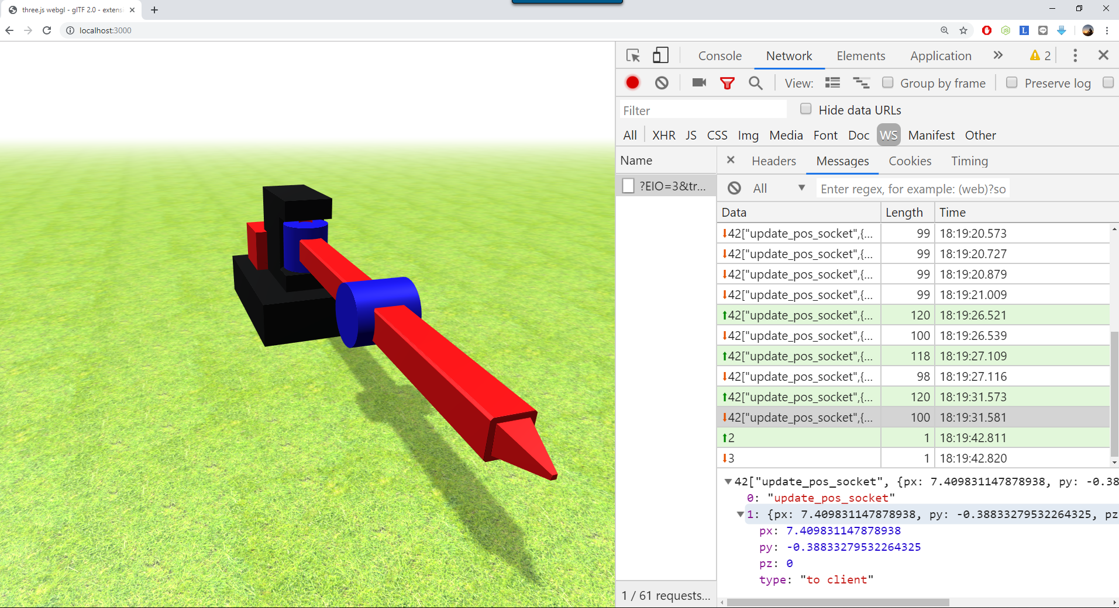

Slide 21
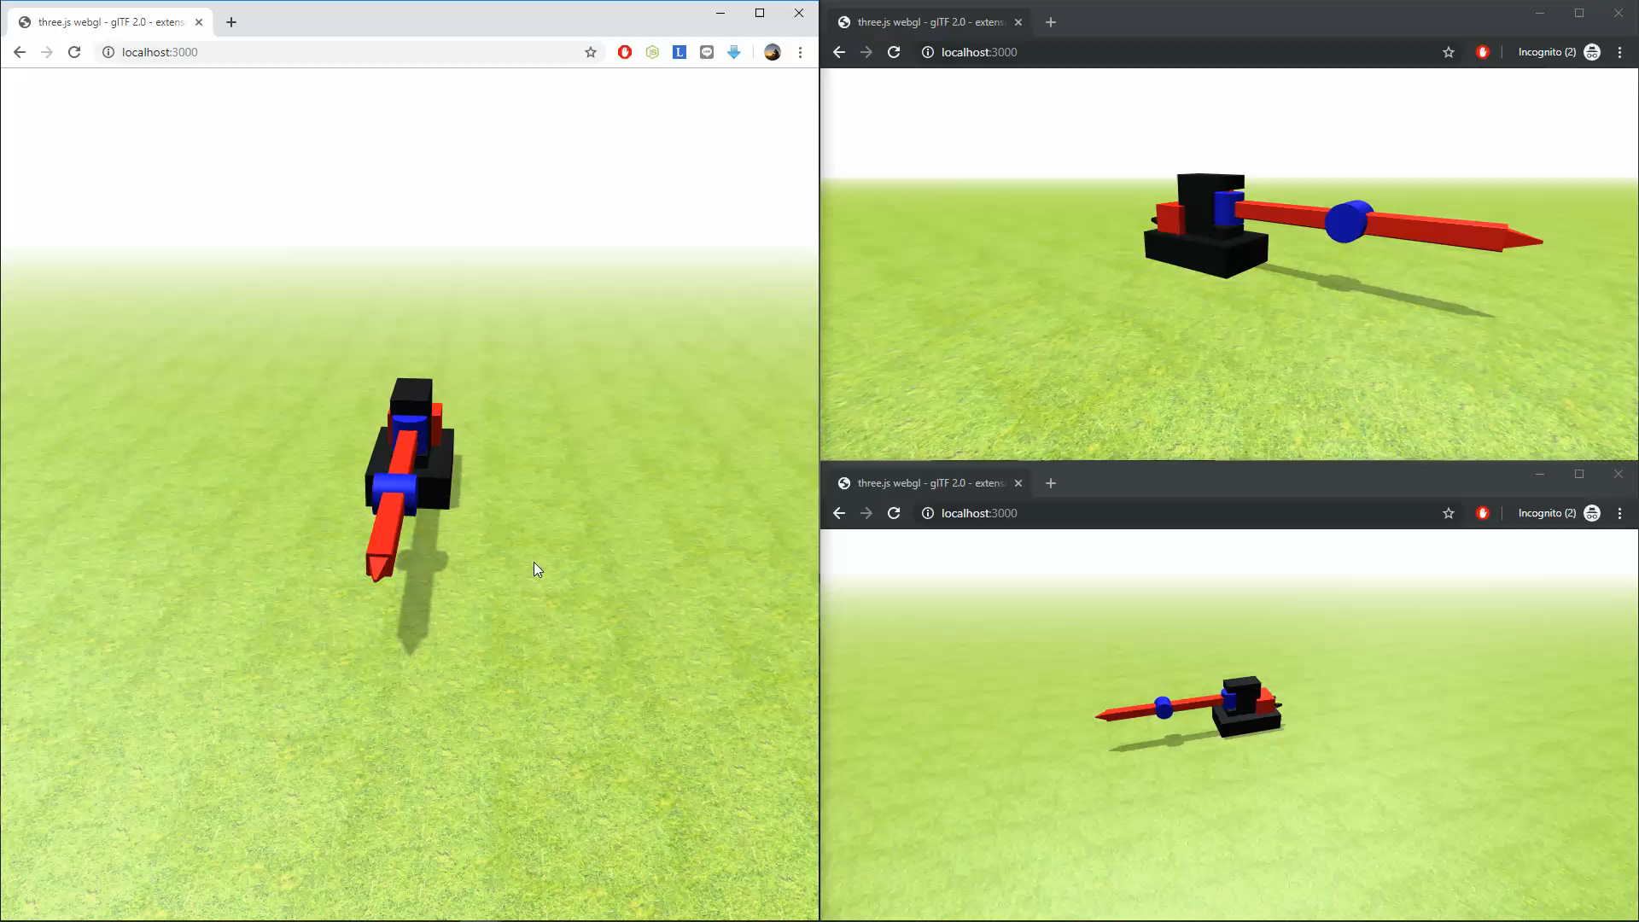
Simulation

Slide 22
Our Rules
Web Socket Server
Web Socket Client
Web Socket ESP8266
on(“connection”)
emit(“connection”)
emit(“connection”)
data = ‘ESP Connected’
emit(“message”)
on(“message”)
on(“update_pos”)
emit(“update_pos”)
emit(“update_pos”)
on(“update_pos”)
on(“update_pos”)
on(“disconnect”)
emit(“disconnect”)

Slide 23
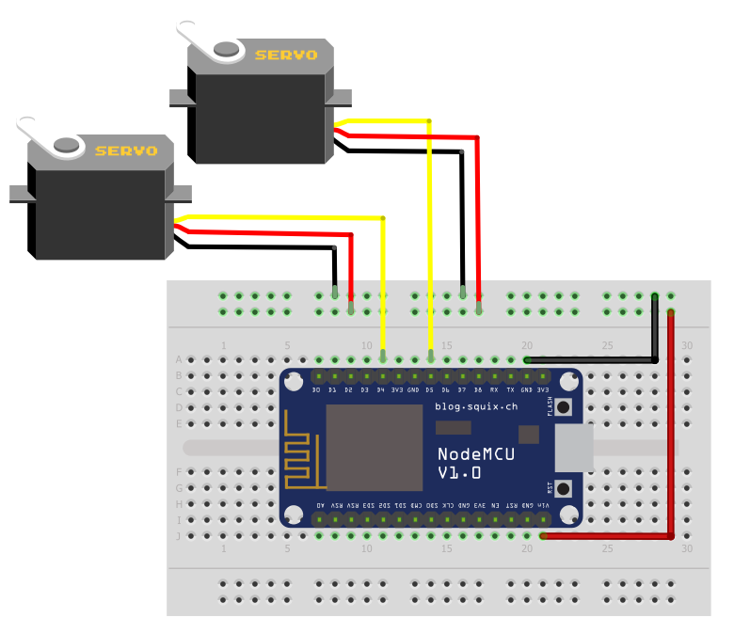
Wiring Diagram
D5
D4

Slide 24
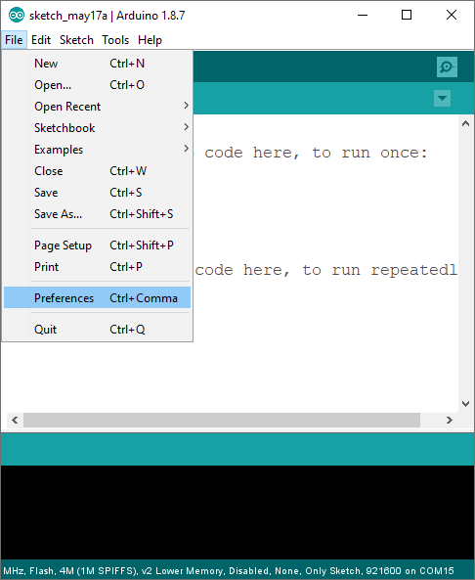
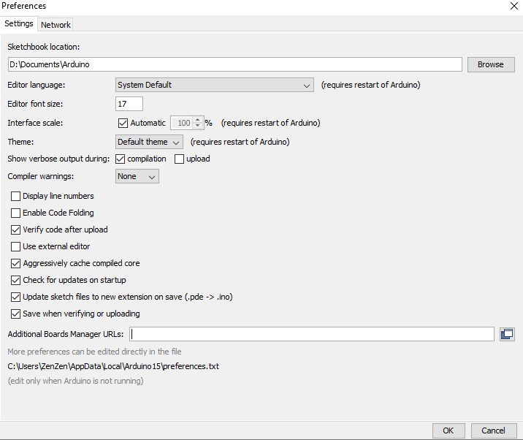
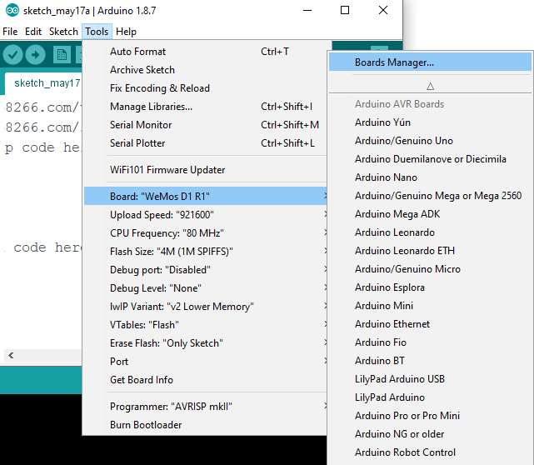
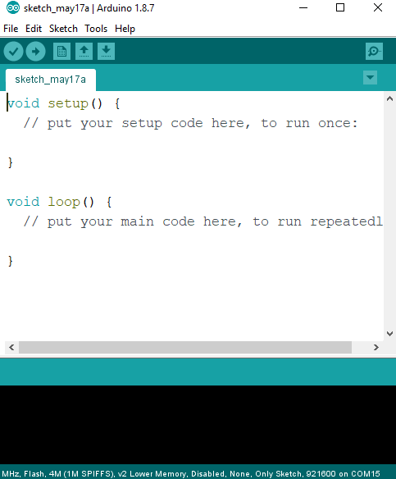
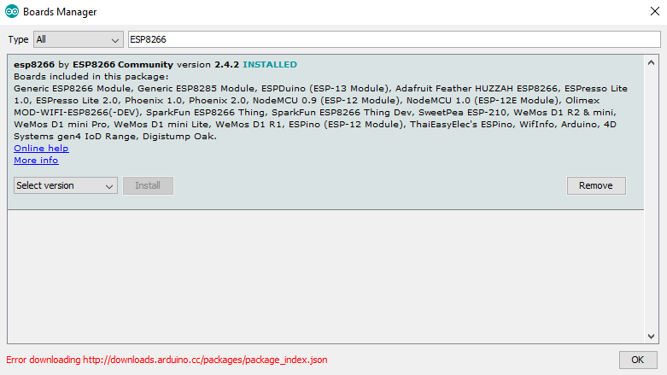
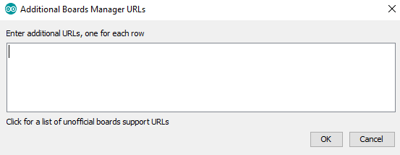
Setup Board
paste this URL then OK
http://arduino.esp8266.com/versions/2.4.2/package_esp8266com_index.json
http://arduino.esp8266.com/stable/package_esp8266com_index.json

Slide 25
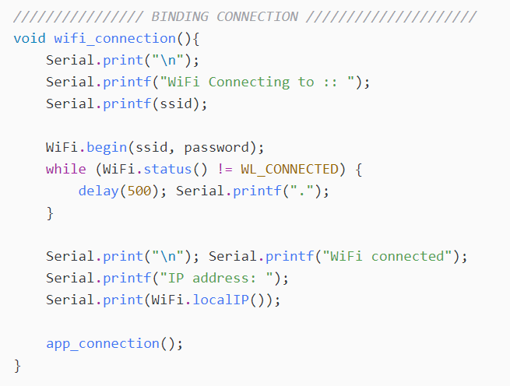
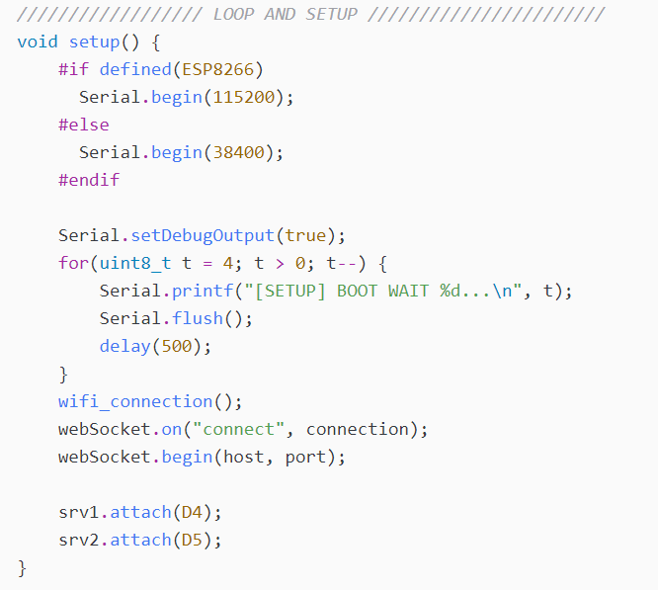
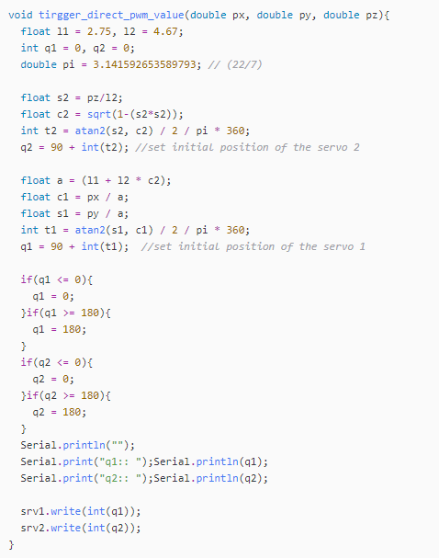
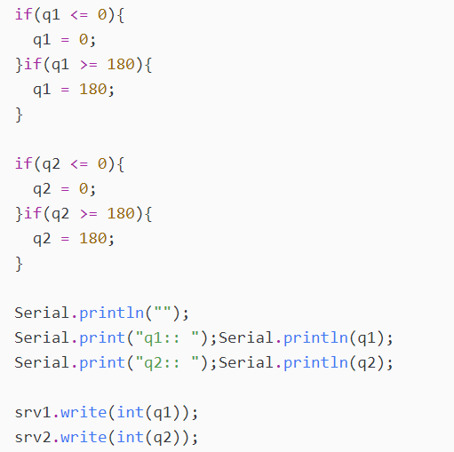
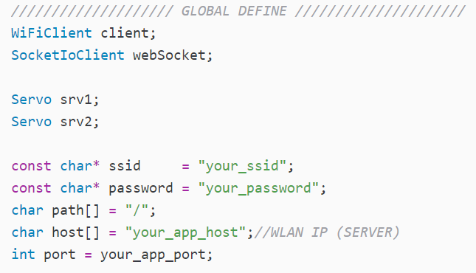
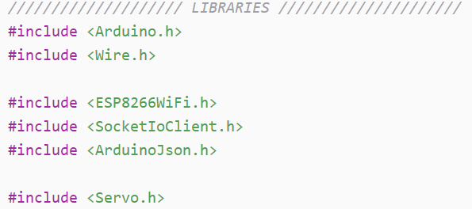
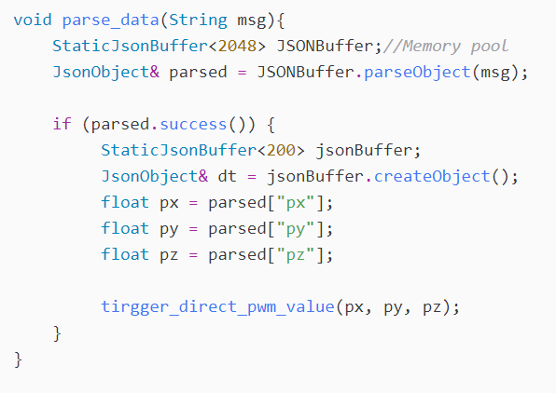
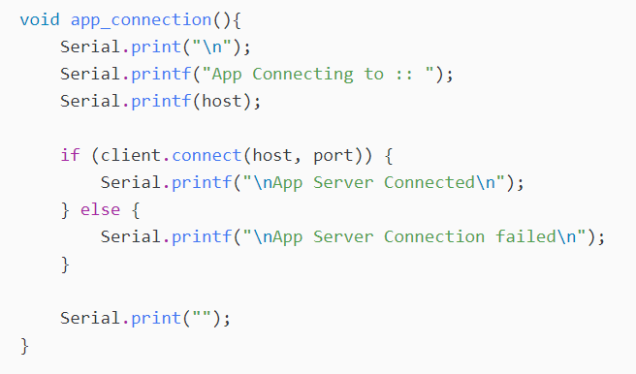
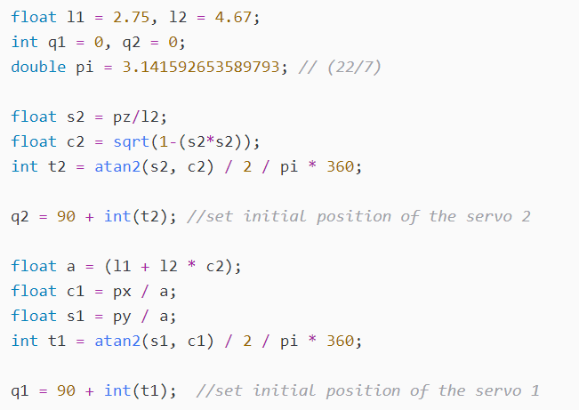
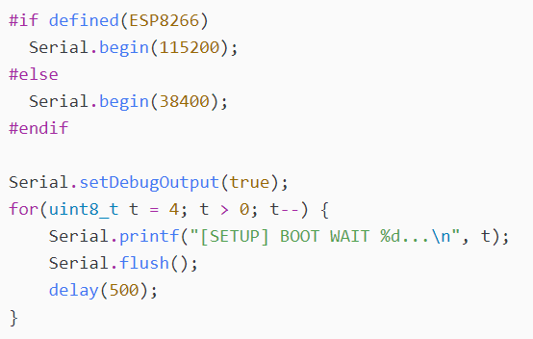
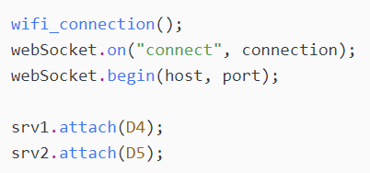
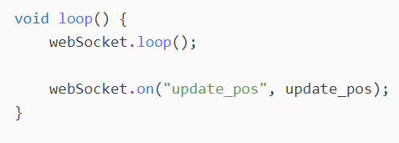
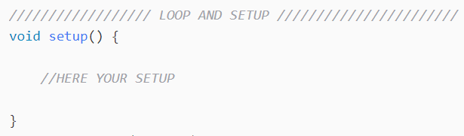
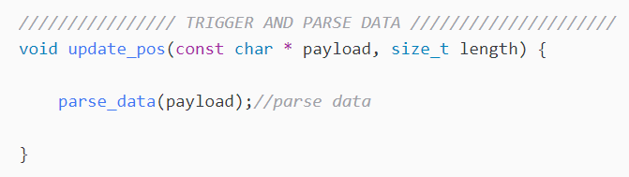
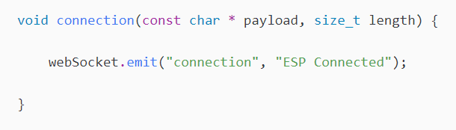

Implementation
esp8266.ino

Slide 26

Run System Together

Slide 27
Zendi Iklima ST, SKom, MSc

